Slide 1





A P I
Pokemon gotta catch em all
API's gotta fetch em all
by Sushant Mishra

Slide 2
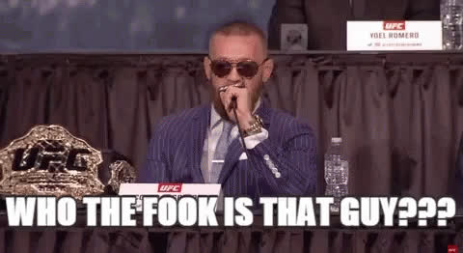

Slide 3
SO HELLO EVERYONE !!
•
Name: Sushant
•
Age: 90000+
•
Your boi is a Hackerabadi
•
Stuff I like to do:
Code (Web Dev.)
Music (Hip-Hop/Rap)

Slide 4

TODAYS AGENDA

Slide 5
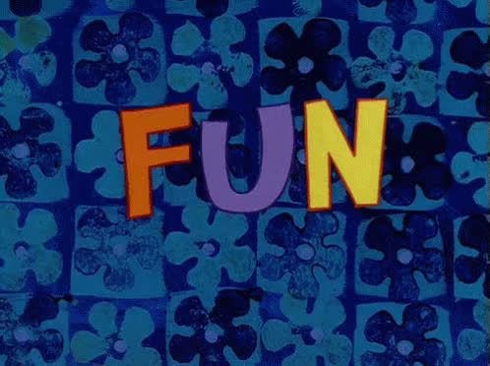

Slide 6
A
P
pplication
rogramming
I
interface

Slide 7

WHAT IS AN
I
?
interface

Slide 8


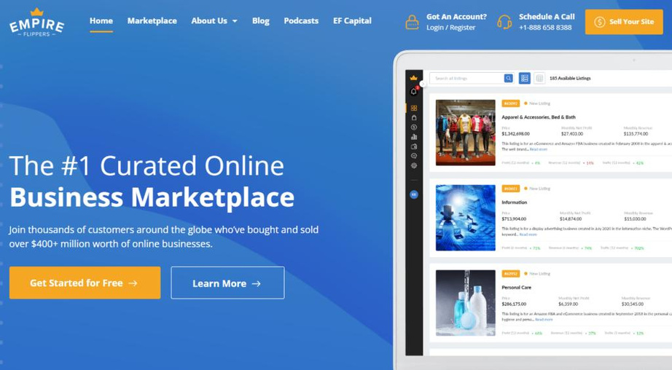
EXAMPLES
TV Remote
Radio
Website

Slide 9




SO THEN AN API IS
An Interface that connects your program with someone else's program.
A P I

Slide 10
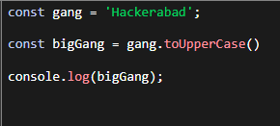
GUESS THE API
A.
B.
C.

Slide 11
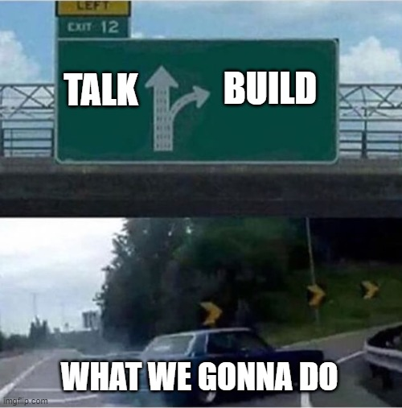

Slide 12
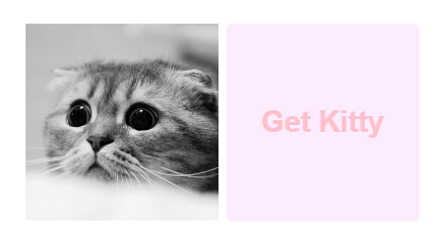
CAT BOT

Slide 13
Requirement
Clicking the button should
Fetch Data
Display the Cat Image

Slide 14
Visit
https://github.com/Sushants-Git/Hackout-APIs
Link in the chat

Slide 15
Wait it's already over ...
Thank a lot for comming !!!!

Slide 16

Some Resources to Learn about API

